Slide 1
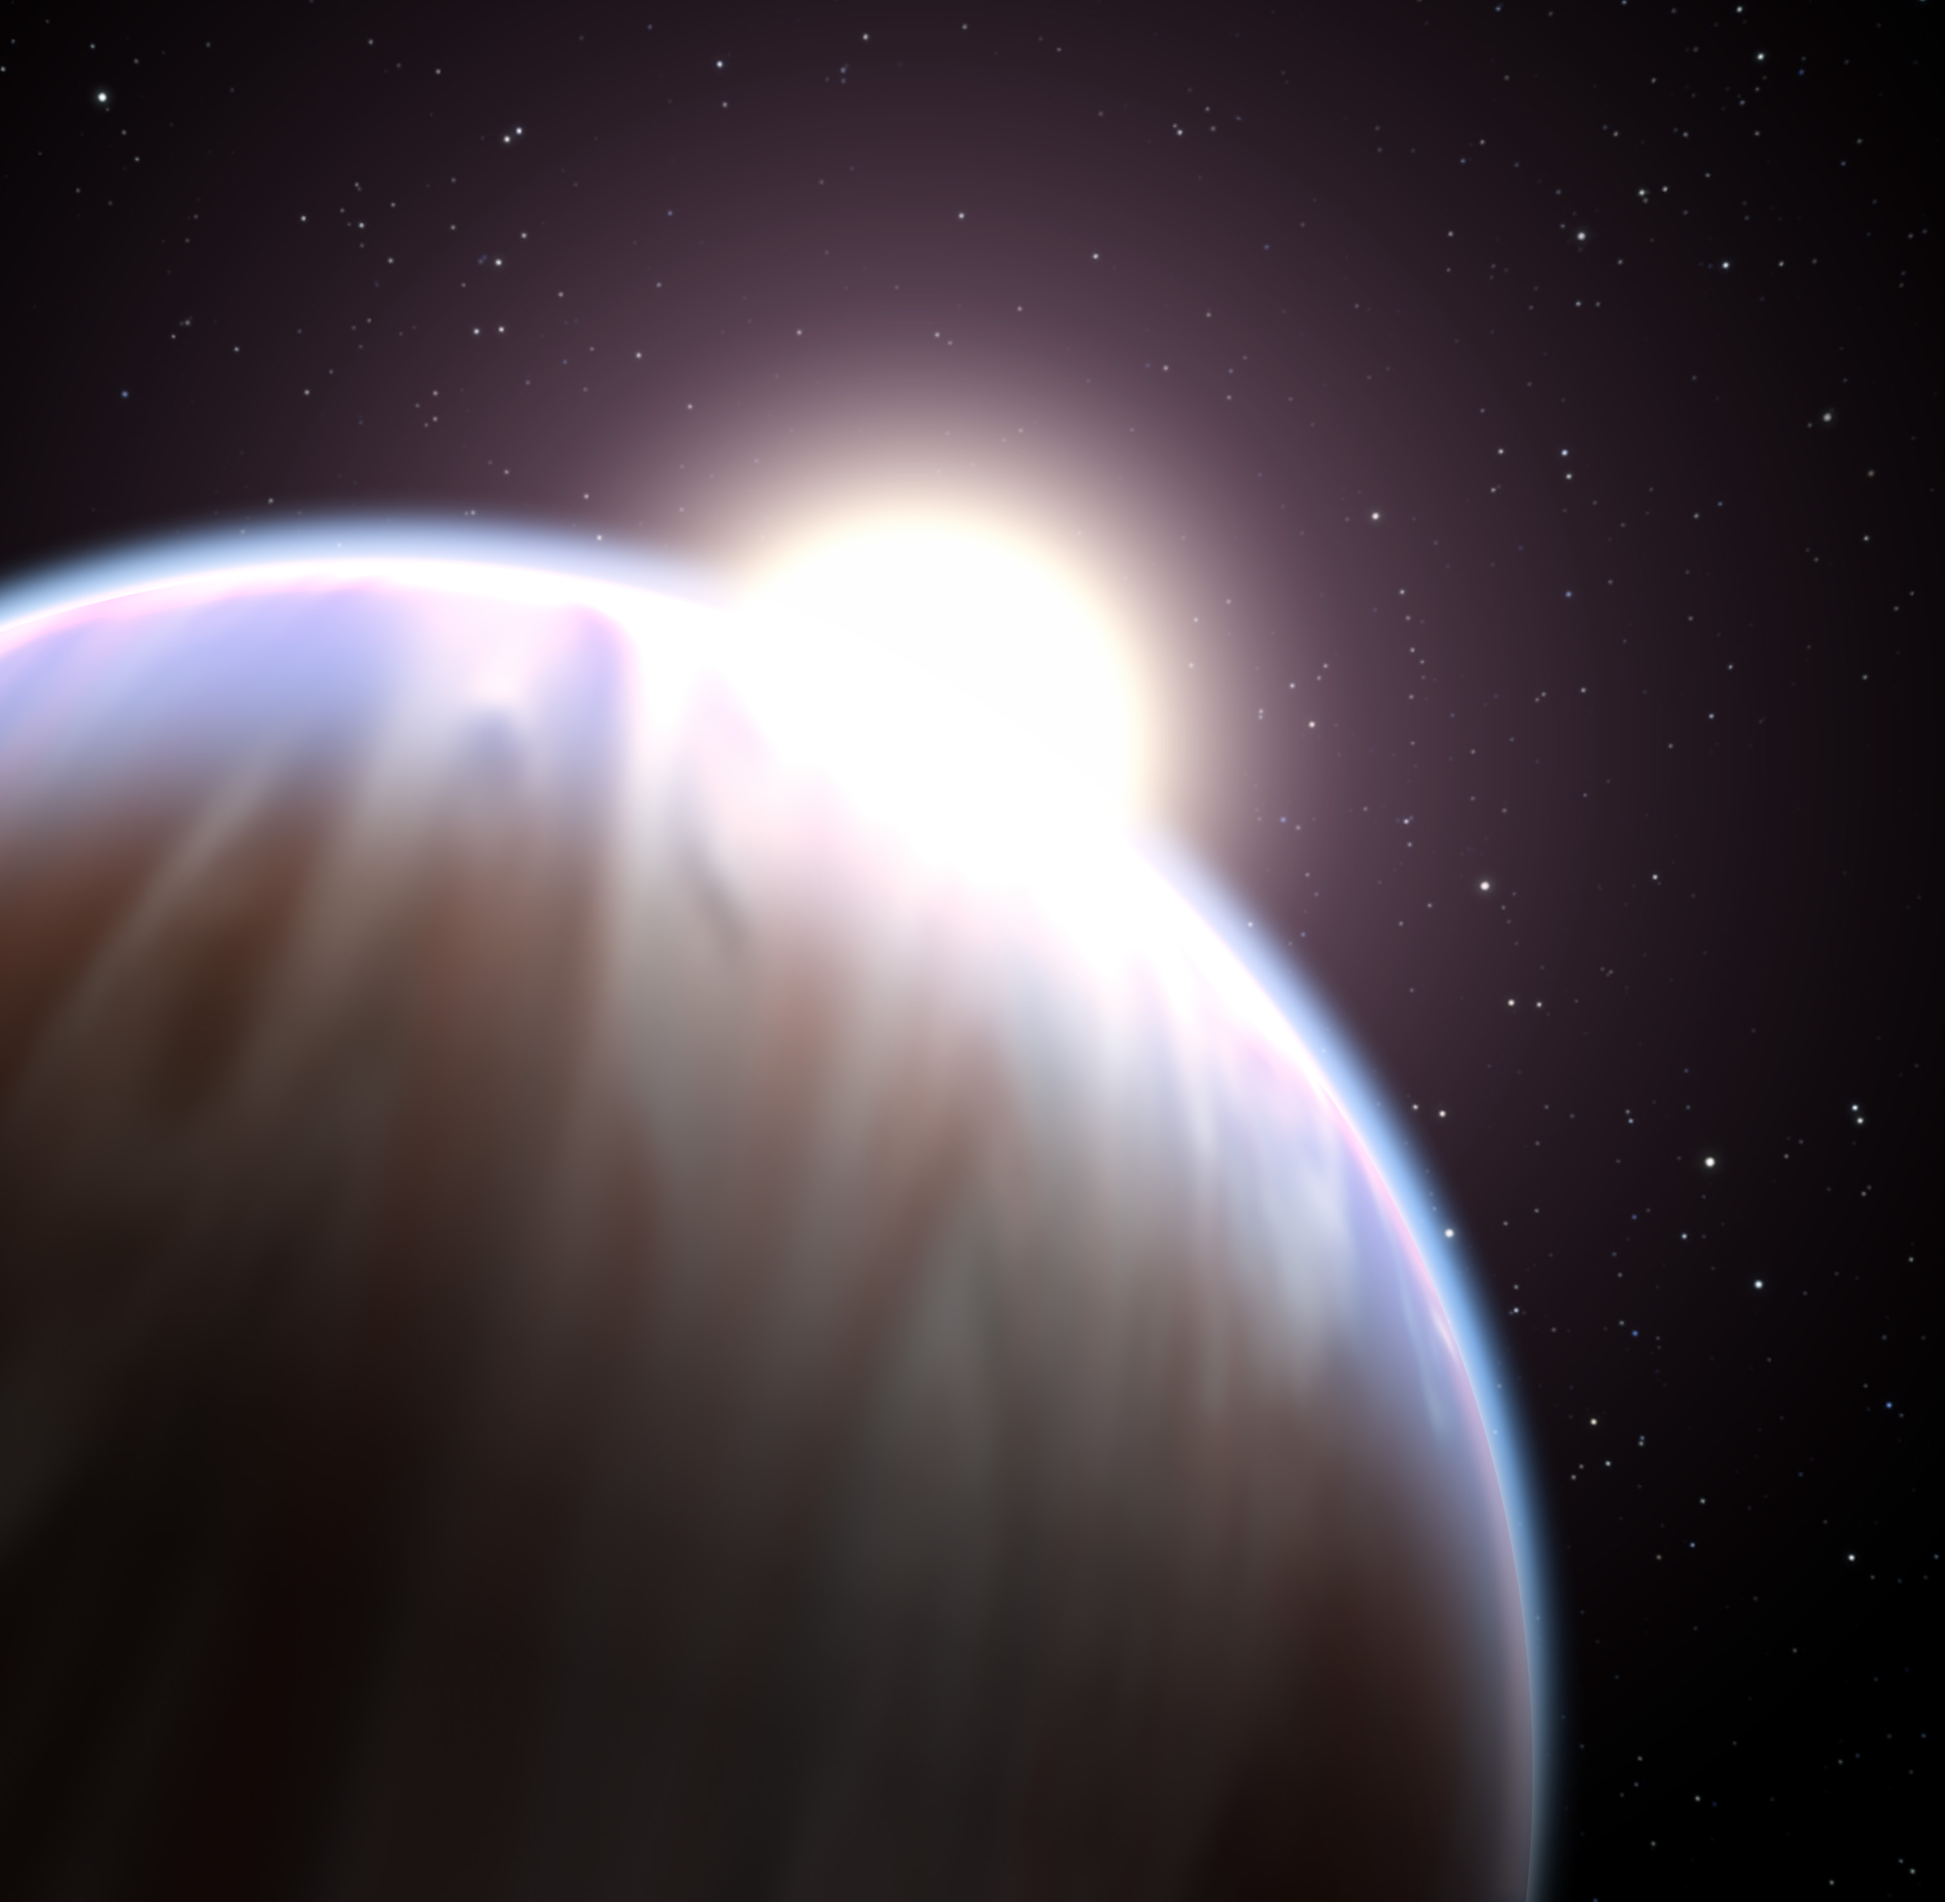


ATMOSPHERIC COMPOSITION BEYOND THE C/O RATIO
Néstor Espinoza
Pontificia Universidad Católica de Chile
Mentors: Jonathan Fortney & Yamila Miguel
CO-Is: K. Lodders & B. Fegley

Slide 2
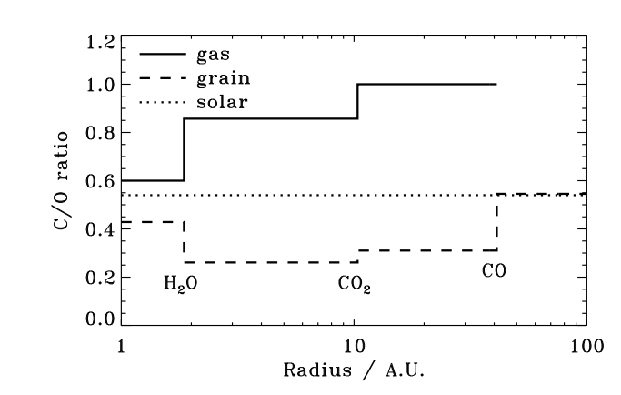
Öberg, Murray-Clay & Bergin (2011)

Slide 3
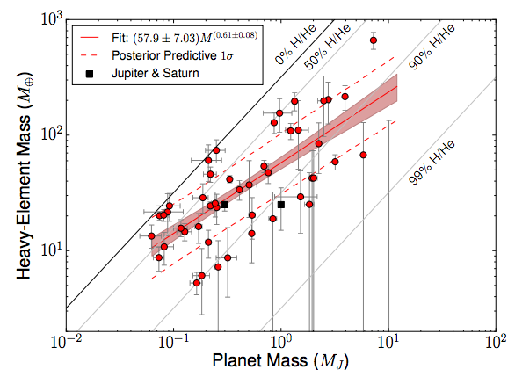
Thorngren et al. (2016)

Slide 4
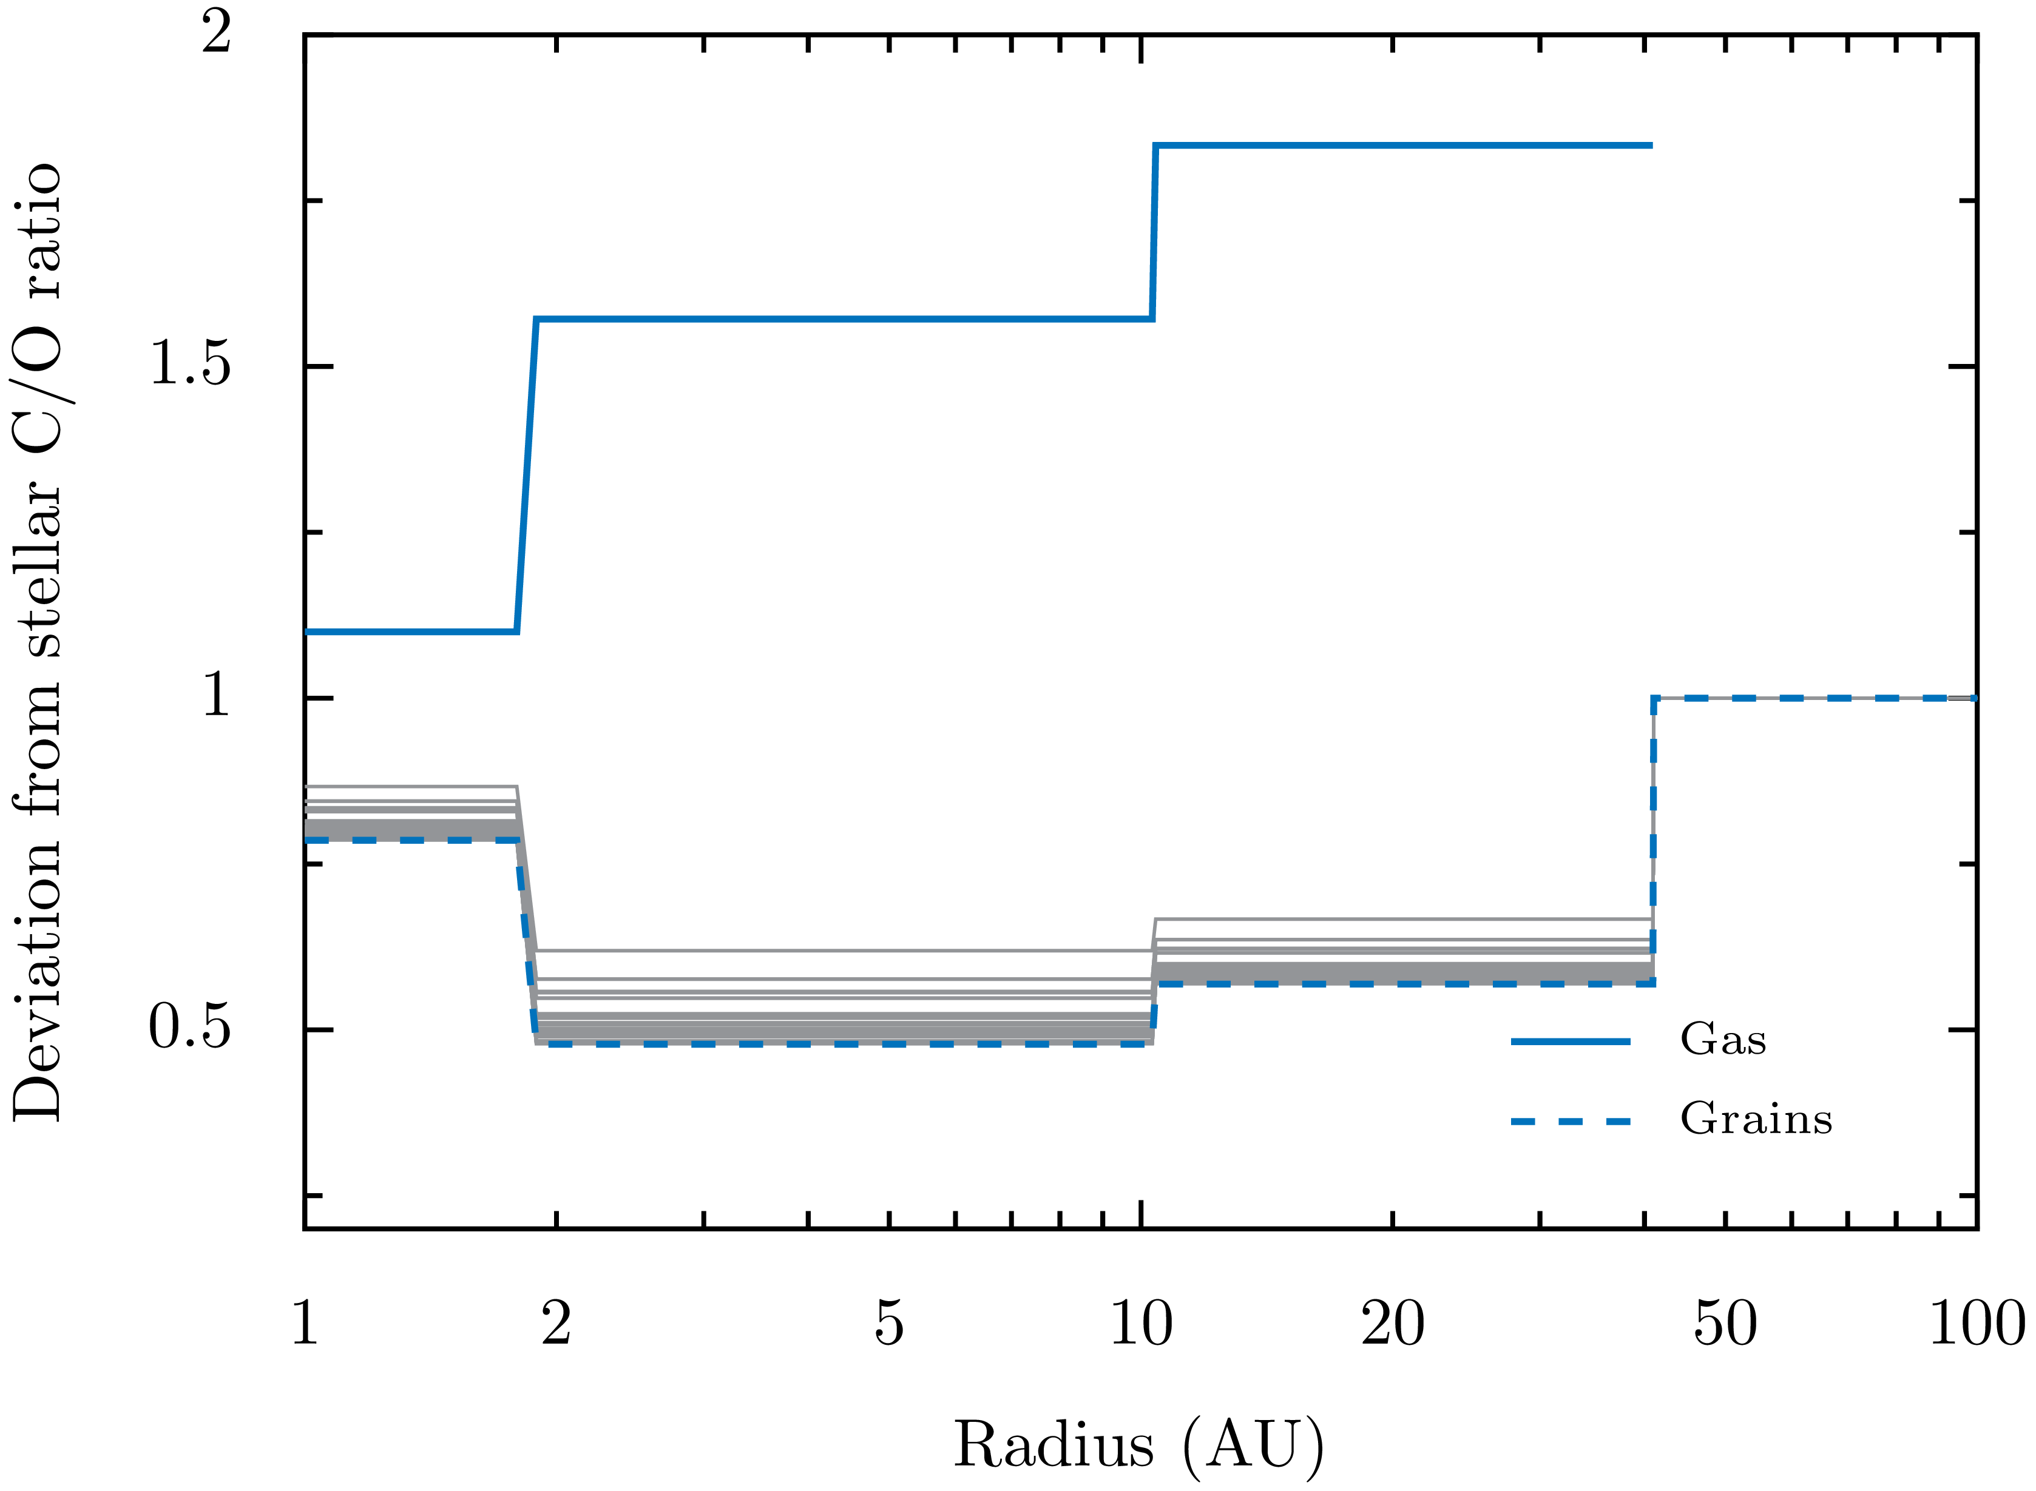
CO
H₂O
CO₂

Slide 5
Beyond the C/O Ratio

Slide 6
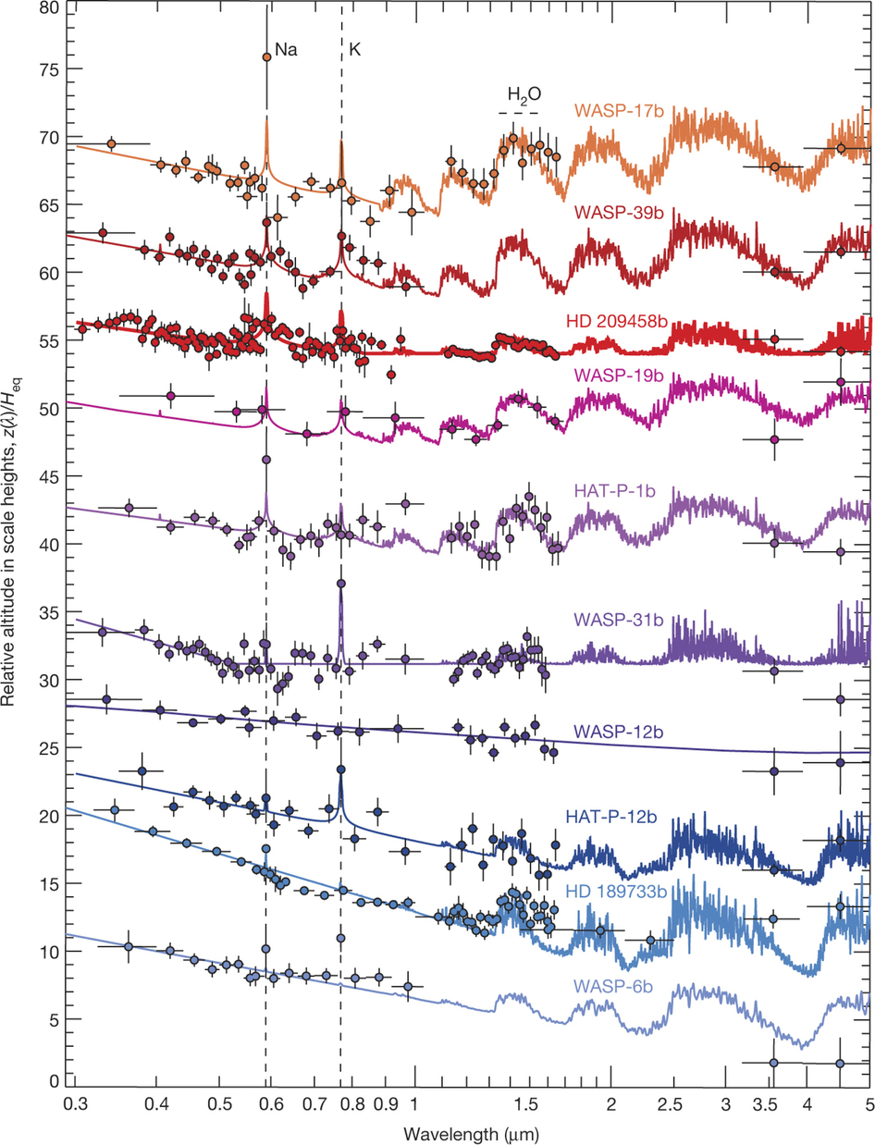
(Sing et al., 2016)

Slide 7
Our “big 6”:
Na, K, Ti, V, Fe, O
(Sing et al., 2016)

Slide 8
Our “big 6”:
Na, K, Ti, V, Fe, O
(Sing et al., 2016)

Slide 9
Our “big 6”:
Na, K, Ti, V, Fe, O
+ (time-evolving) physics
+ (time-evolving) chemistry
(Sing et al., 2016)

Slide 10
THE MODEL
1+1D Chambers (2009) disk model.

Slide 11
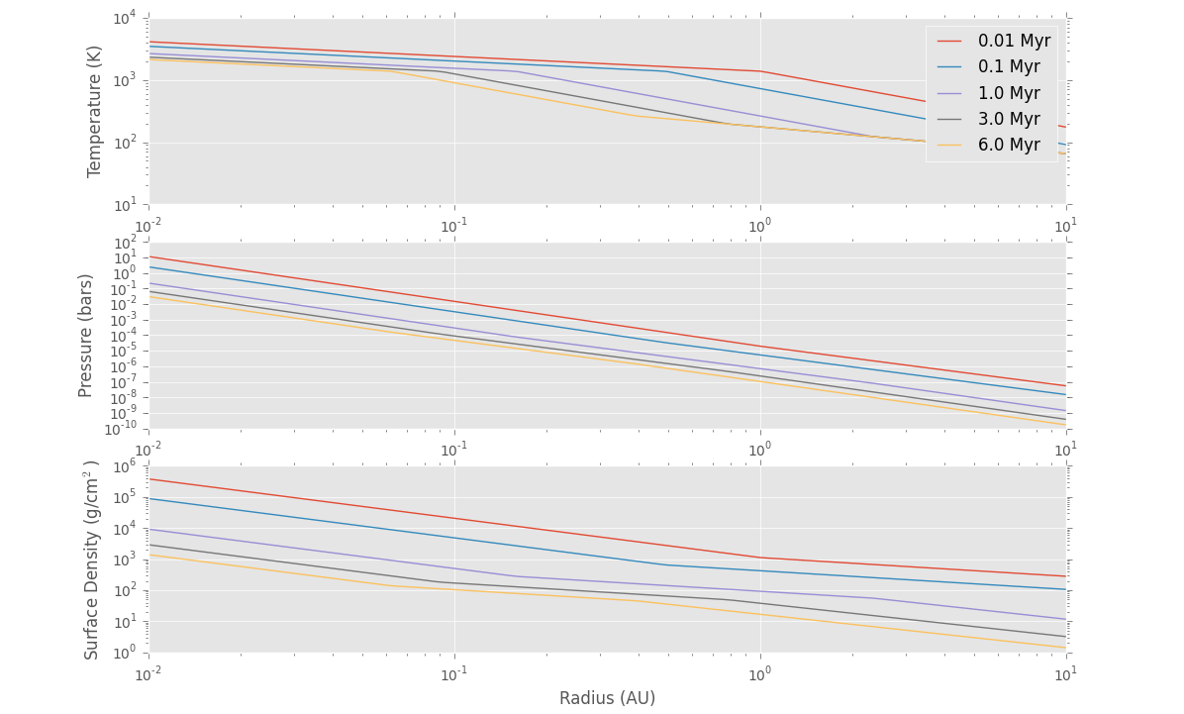
THE MODEL
1+1D Chambers (2009) disk model.

Slide 12
THE MODEL
1+1D Chambers (2009) disk model.
Chemical equilibrium (w/ CEA).

Slide 13
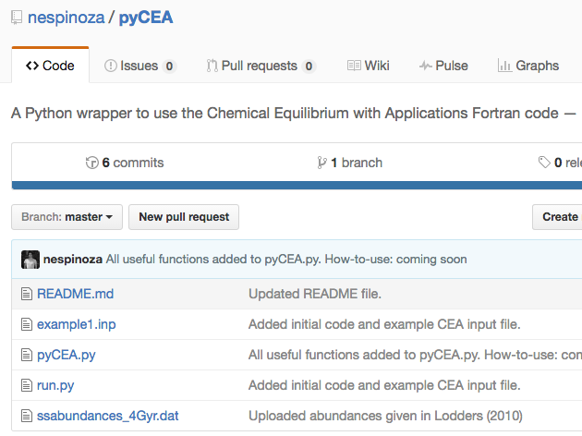
THE MODEL
1+1D Chambers (2009) disk model.
Chemical equilibrium (w/ CEA).
(github.com/nespinoza/pyCEA)

Slide 14
THE MODEL
Chemical network
Lodders et al. (2003)
Moriarty et al. (2014)

Slide 15
THE MODEL
Chemical network
Gas species: Al AlN AlC AlH AlH₂ ALO ALOH ALS
C CH₄ CN CO CO₂ CS
Ca CaH CaO CaOH CaS
K KCN KH KOH
Fe FeH FeO FeS Fe(OH)₂
H H₂ H₂O H₂S HCN HCO HS
He
Mg MgH MgN MgO MgOH MgS
Solid species:
NaAlSi₃O₈
KAlSi₃O₈
MgAl₂O₄
Al₂O₃
Ca₂Al₂SiO₇
N N₂ NH NH₃ NO
Na Na₂ NaH NaO NaOH
O O₂ OH
S S₂ SN SO SO₂
Si SiH SiH₄ SiN SiO SiS
Ti TiO TiO₂ TiS
V VN VO VO₂
Mg₂SiO₄
Fe(a,c)
FeS(a,b,c)
CaAl₁₂O₁₉
CaAl₂Si₂O₈
Al
Fe(a,c)
FeS(a,b,c)
CaAl₁₂O₁₉
CaAl₂Si₂O₈
CaTiO₃
TiN
Ti₂O₃
V₂O₃
Fe₃O₄
MgS
MgSiO₃

Slide 16
THE MODEL
Chemical network
Gas species: Al AlN AlC AlH AlH₂ ALO ALOH ALS
C CH₄ CN CO CO₂ CS
Ca CaH CaO CaOH CaS
K KCN KH KOH
Fe FeH FeO FeS Fe(OH)₂
H H₂ H₂O H₂S HCN HCO HS
He
Mg MgH MgN MgO MgOH MgS
Solid species:
NaAlSi₃O₈
KAlSi₃O₈
MgAl₂O₄
Al₂O₃
Ca₂Al₂SiO₇
N N₂ NH NH₃ NO
Na Na₂ NaH NaO NaOH
O O₂ OH
S S₂ SN SO SO₂
Si SiH SiH₄ SiN SiO SiS
Ti TiO TiO₂ TiS
V VN VO VO₂
Mg₂SiO₄
Fe(a,c)
FeS(a,b,c)
CaAl₁₂O₁₉
CaAl₂Si₂O₈
Al
Fe(a,c)
FeS(a,b,c)
CaAl₁₂O₁₉
CaAl₂Si₂O₈
CaTiO₃
TiN
Ti₂O₃
V₂O₃
Fe₃O₄
MgS
MgSiO₃

Slide 17
Results pt. I

Slide 18
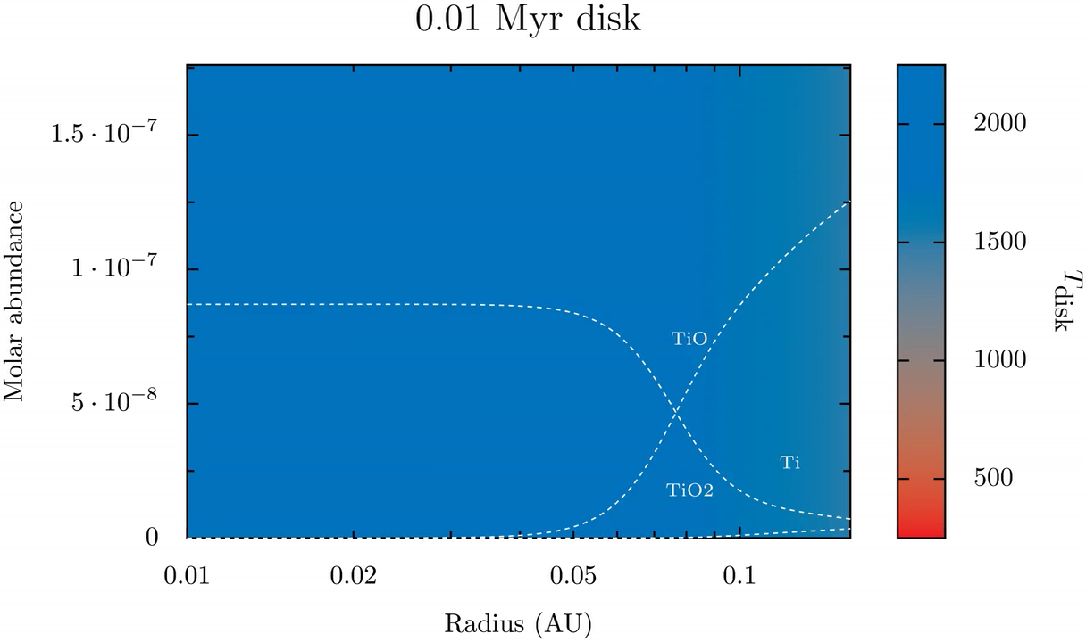
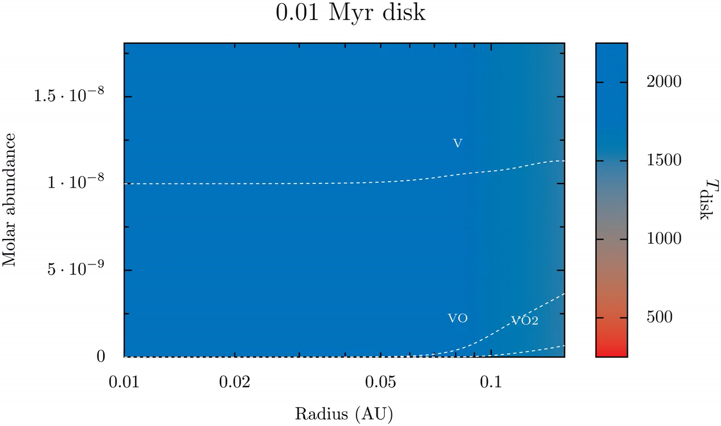
Molar fraction
Radius (AU)

Slide 19
Molar fraction
Radius (AU)

Slide 20
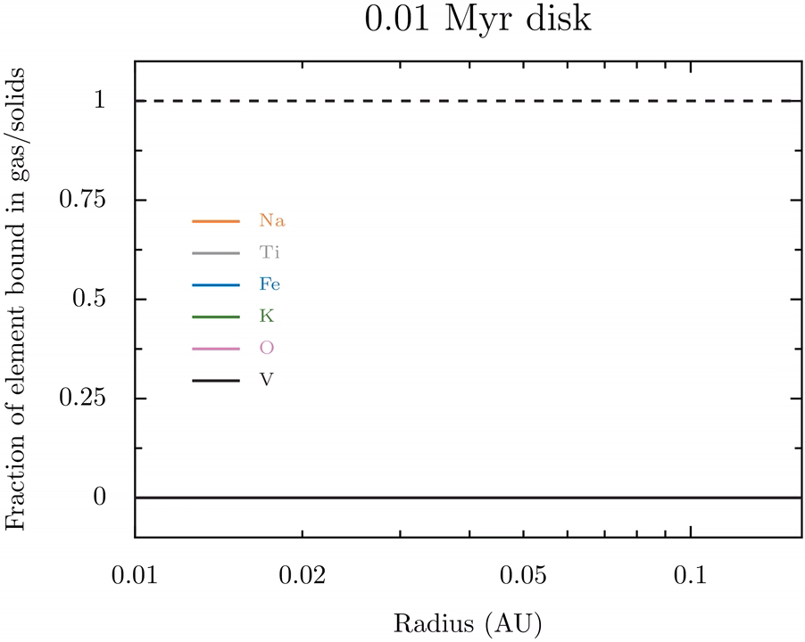

Slide 22
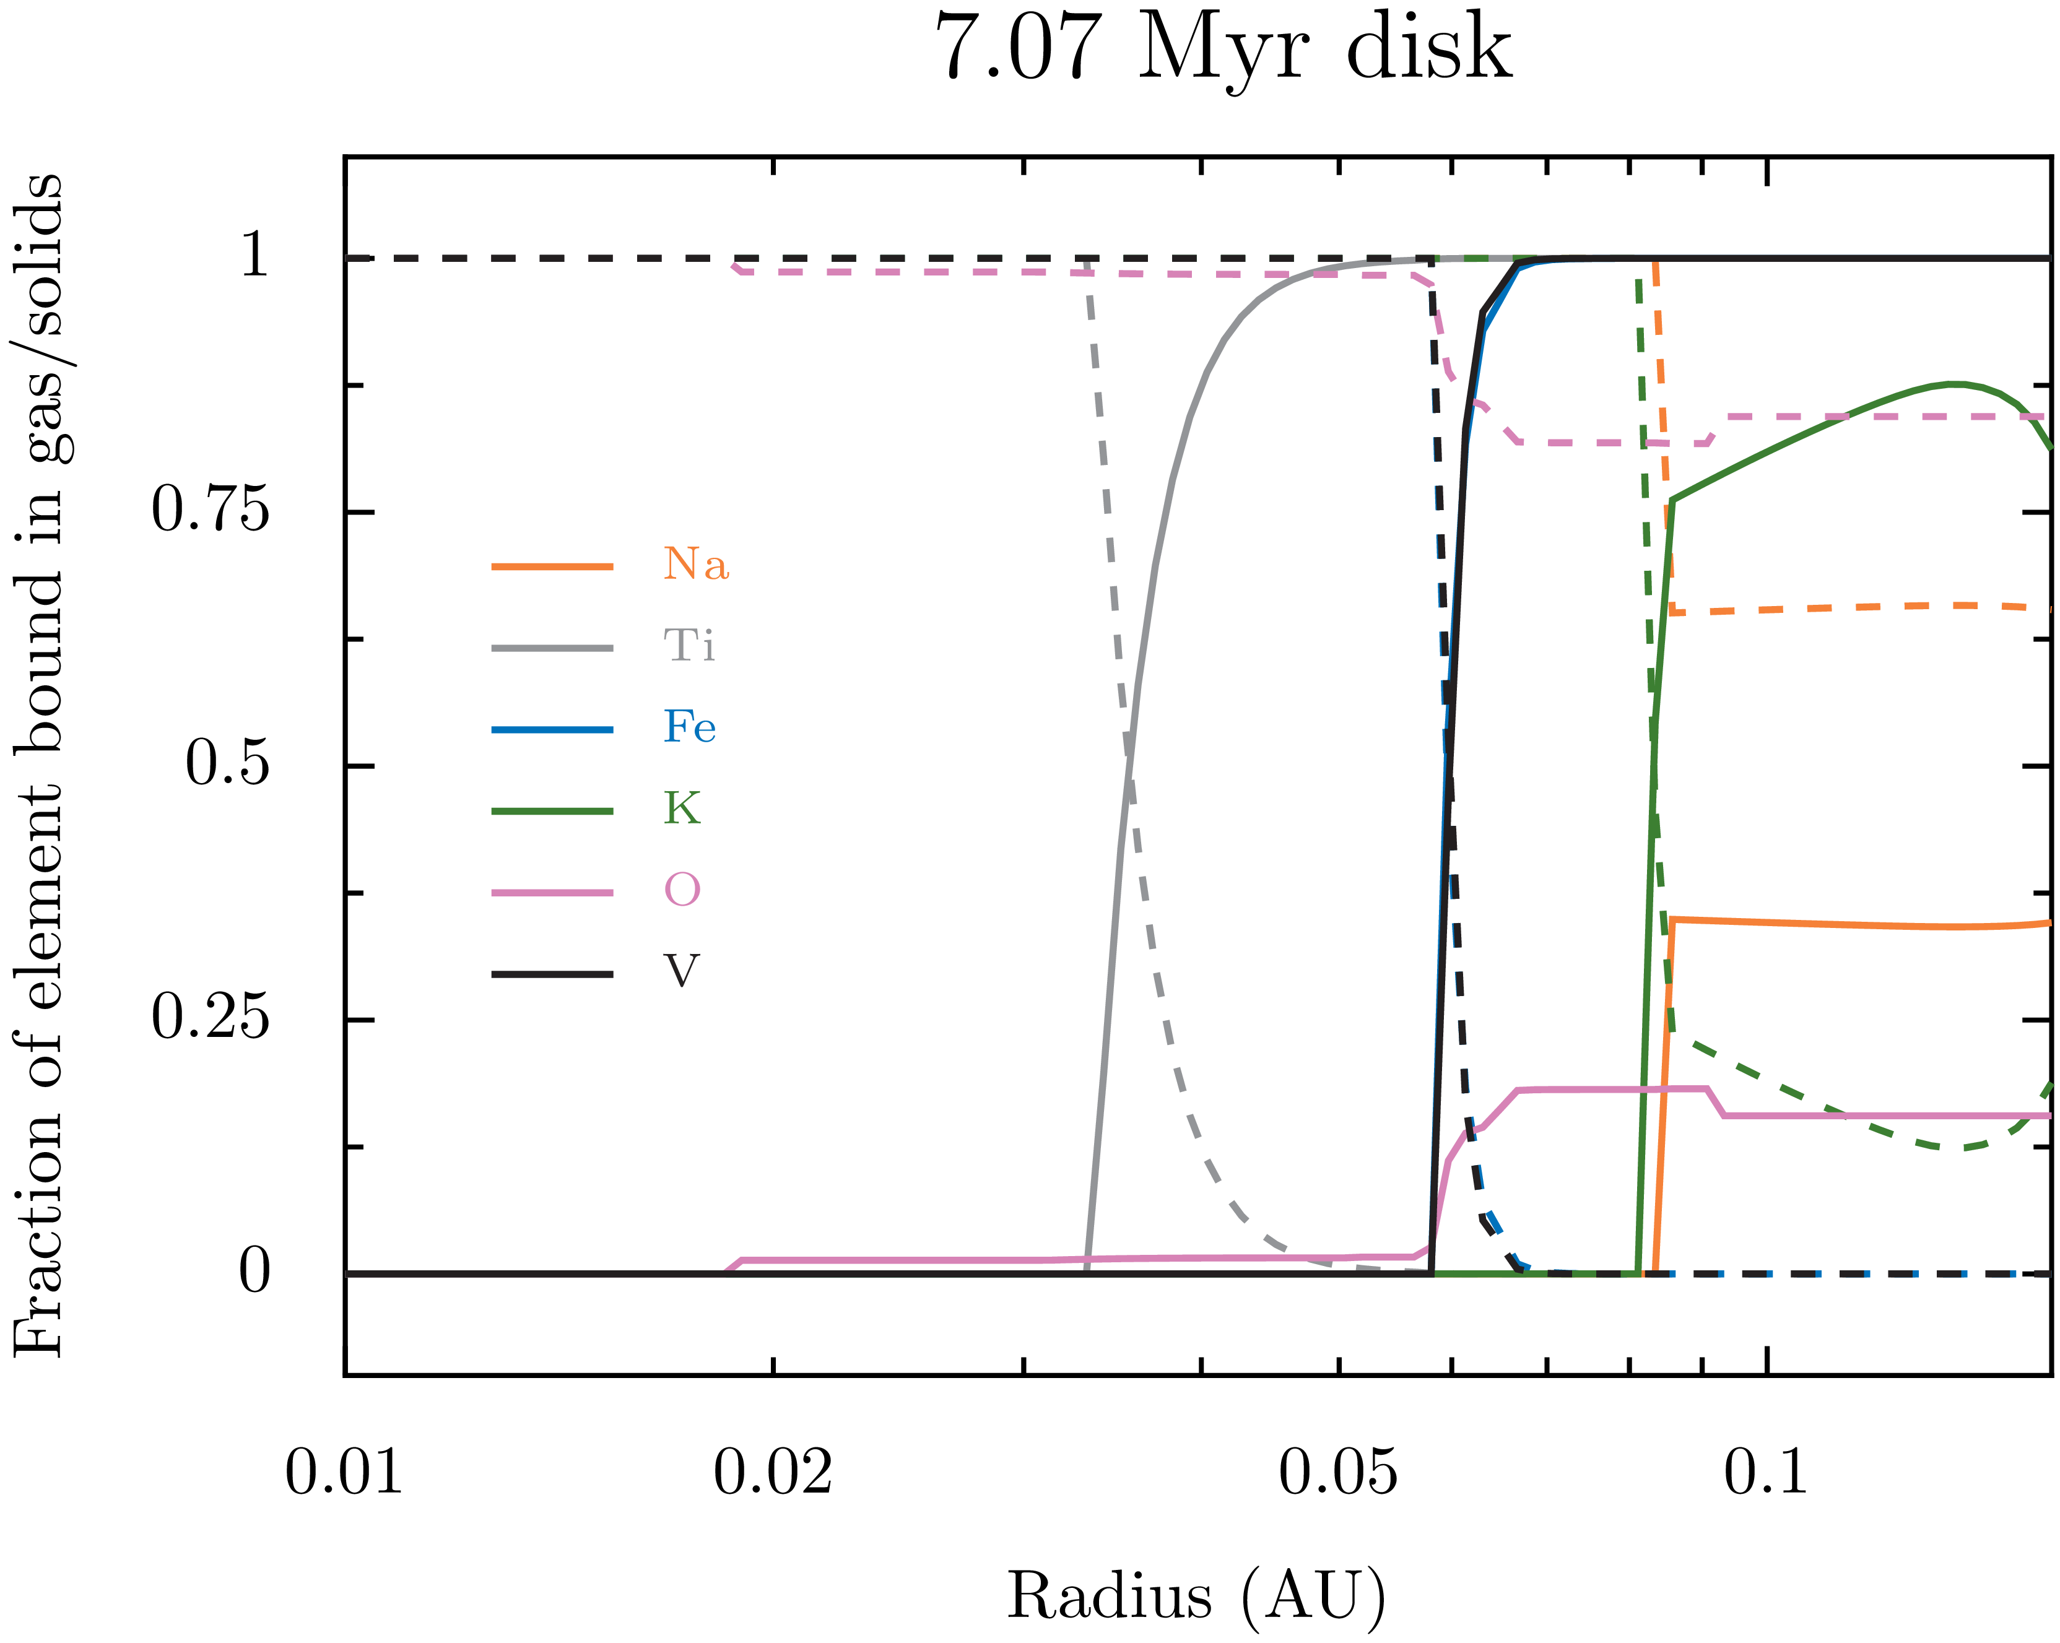

Slide 24

Results pt. II

Slide 25
TWO IN-SITU PLANETS

Slide 26
TWO IN-SITU PLANETS

Slide 27
TWO IN-SITU PLANETS

Slide 28
0.1 AU IN-SITU PLANET
Miguel & Brunini (2008, 2009, 2010)
Miguel et al. (2011a, 2011b)
M_{core} = 5.65M_{Earth} M_{envelope} = 0.6M_{Jup}
X_{env} = 0.69 Y_{env} = 0.27 Z_{env} = 0.04 (3x solar)

Slide 29
0.1 AU IN-SITU PLANET
Miguel & Brunini (2008, 2009, 2010)
Miguel et al. (2011a, 2011b)
M_{core} = 5.65M_{Earth} M_{envelope} = 0.6M_{Jup}
X_{env} = 0.69 Y_{env} = 0.27 Z_{env} = 0.04 (3x solar)

Slide 30
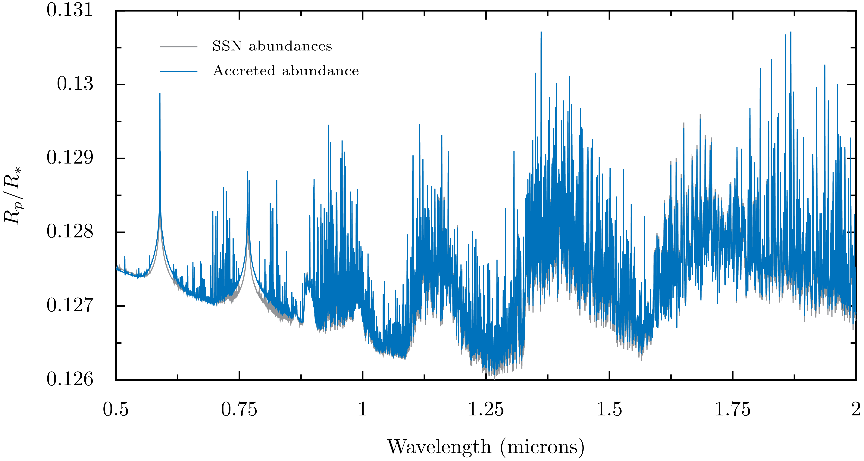
0.1 AU IN-SITU PLANET
Miguel & Brunini (2008, 2009, 2010)
Miguel et al. (2011a, 2011b)

Slide 31
0.1 AU IN-SITU PLANET
Miguel & Brunini (2008, 2009, 2010)
Miguel et al. (2011a, 2011b)
50 ppm!

Slide 32
0.05 AU IN-SITU PLANET
Miguel & Brunini (2008, 2009, 2010)
Miguel et al. (2011a, 2011b)

Slide 33
0.05 AU IN-SITU PLANET
Miguel & Brunini (2008, 2009, 2010)
Miguel et al. (2011a, 2011b)
M_{core} = 4.57M_{Earth} M_{envelope} = 1.75M_{Jup}
X_{env} = 0.71 Y_{env} = 0.27 Z_{env} = 0.02 (1.4x solar)

Slide 34
0.05 AU IN-SITU PLANET
Miguel & Brunini (2008, 2009, 2010)
Miguel et al. (2011a, 2011b)
M_{core} = 4.57M_{Earth} M_{envelope} = 1.75M_{Jup}
X_{env} = 0.71 Y_{env} = 0.27 Z_{env} = 0.02 (1.4x solar)

Slide 35
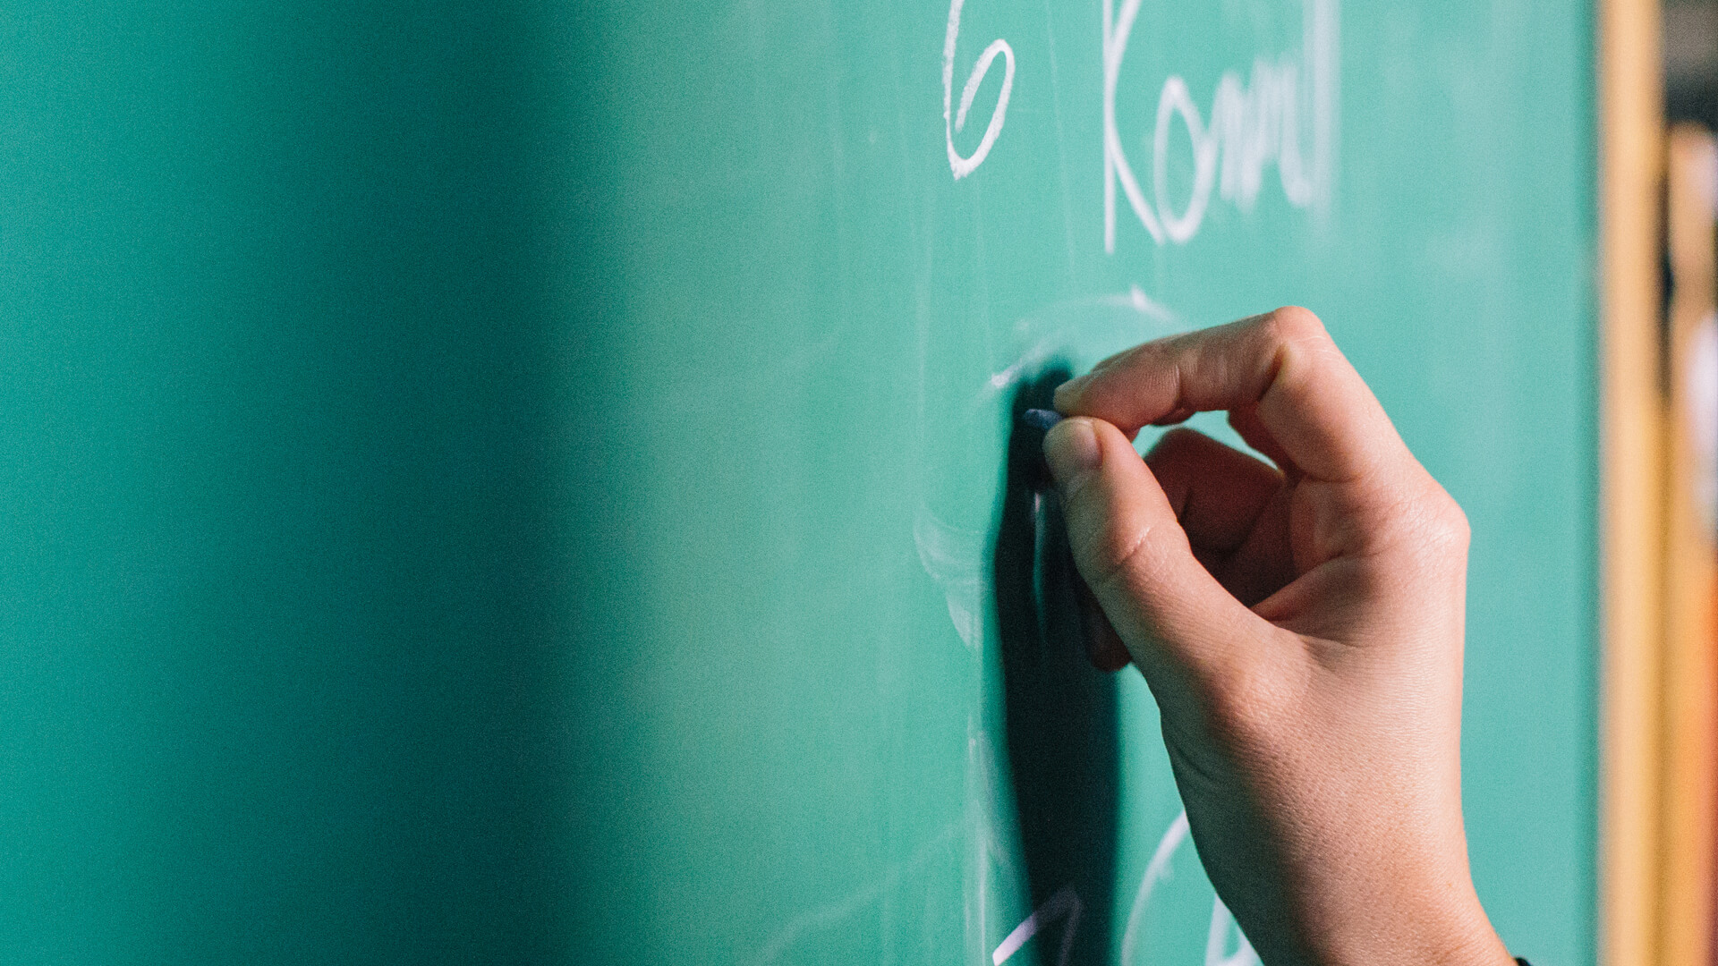
A PICTURE IS WORTH A THOUSAND WORDS
A complex idea can be conveyed with just a single still image, namely making it possible to absorb large amounts of data quickly.

Slide 36
USE CHARTS TO EXPLAIN YOUR IDEAS
WHITE
GRAY
BLACK

Slide 37
AND TABLES TO COMPARE DATA
 | A | B | C
Yellow | 10 | 20 | 7
Blue | 30 | 15 | 10
Orange | 5 | 24 | 16

Slide 38
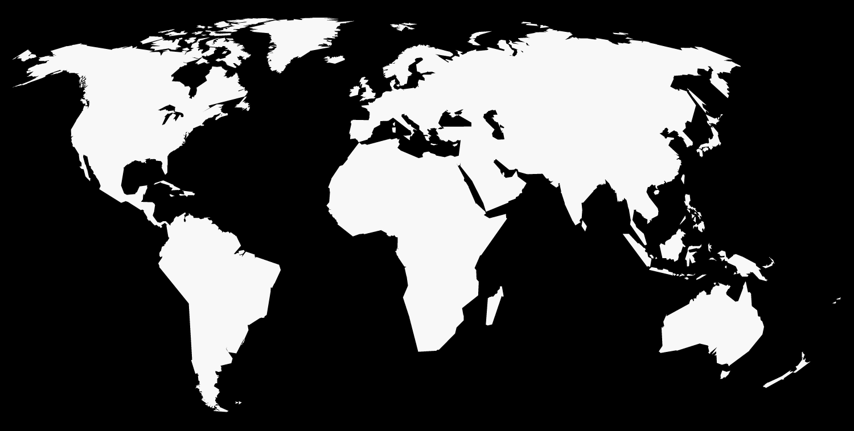
MAPS
our office

Slide 39
89,526,124
Whoa! That’s a big number, aren’t you proud?

Slide 40
89,526,124$
185,244 users
100%
That’s a lot of money
And a lot of users
Total success!

Slide 41
OUR PROCESS IS EASY
First
Second
Last

Slide 42
LET’S REVIEW SOME CONCEPTS
Yellow
Is the color of gold, butter and ripe lemons. In the spectrum of visible light, yellow is found between green and orange.
Blue
Is the colour of the clear sky and the deep sea. It is located between violet and green on the optical spectrum.
Red
Is the color of blood, and because of this it has historically been associated with sacrifice, danger and courage.
Yellow
Is the color of gold, butter and ripe lemons. In the spectrum of visible light, yellow is found between green and orange.
Blue
Is the colour of the clear sky and the deep sea. It is located between violet and green on the optical spectrum.
Red
Is the color of blood, and because of this it has historically been associated with sacrifice, danger and courage.

Slide 43
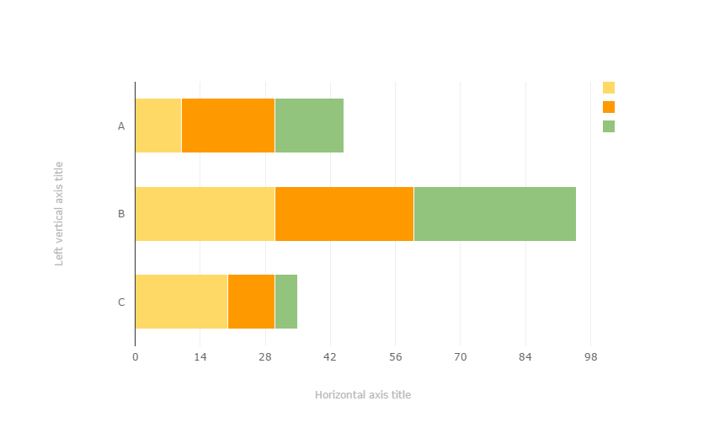
You can copy&paste graphs from Google Sheets

Slide 44
ANDROID PROJECT
Place your screenshot here
Show and explain your web, app or software projects using these gadget templates.

Slide 45
IPHONE PROJECT
Place your screenshot here
Show and explain your web, app or software projects using these gadget templates.

Slide 46
TABLET PROJECT
Place your screenshot here
Show and explain your web, app or software projects using these gadget templates.

Slide 47
DESKTOP PROJECT
Place your screenshot here
Show and explain your web, app or software projects using these gadget templates.

Slide 48
THANKS!
Any questions?
You can find me at @username & user@mail.me

Slide 49
CREDITS
Special thanks to all the people who made and released these awesome resources for free:
Presentation template by SlidesCarnival
Photographs by Death to the Stock Photo (license)

Slide 50

PRESENTATION DESIGN
You don’t need to keep this slide in your presentation. It’s only here to serve you as a design guide if you need to create new slides or download the fonts to edit the presentation in PowerPoint®
This presentations uses the following typographies and colors:
Titles: Montserrat
Body copy: Karla
You can download the fonts on this page:
http://www.google.com/fonts/#UsePlace:use/Collection:Montserrat:400,700|Karla:400,400italic,700,700italic
Click on the “arrow button” that appears on the top right
Red #F44336 Deep orange #FF5722 Orange #FF9800 Amber #FFC107
Yellow #FFEB3B Lime #CDDC39 Green #8BC34A Dark green #4CAF50
Teal #009688 Cyan #00BCD4 Blue #03A9F4 Dark blue #2196F3
Indigo #3F51B5 Deep Purple #673AB7 Purple #9C27B0 Magenta #E91E63
Blue gray #607D8B

Slide 51
SlidesCarnival icons are editable shapes.
This means that you can:
Resize them without losing quality.
Change line color, width and style.
Isn’t that nice? :)
Examples:

Slide 52
😉
Now you can use any emoji as an icon!
And of course it resizes without losing quality and you can change the color.
How? Follow Google instructions https://twitter.com/googledocs/status/730087240156643328
✋👆👉👍👤👦👧👨👩👪💃🏃💑❤😂😉😋😒😭👶😸🐟🍒🍔💣📌📖🔨🎃🎈🎨🏈🏰🌏🔌🔑 and many more...

